Slide 1
MSDS 670 Week 8 Assignment Lindsay Pritikin 3/6/22

Slide 2
Introduction
This analysis is focused on data from the Superstore Subset dataset including category and product sales over 2013-2016
The purpose is to review 2016 sales performance for the Superstore Subset dataset compared to prior years, and develop recommendations for 2017 goals and focuses

Slide 3
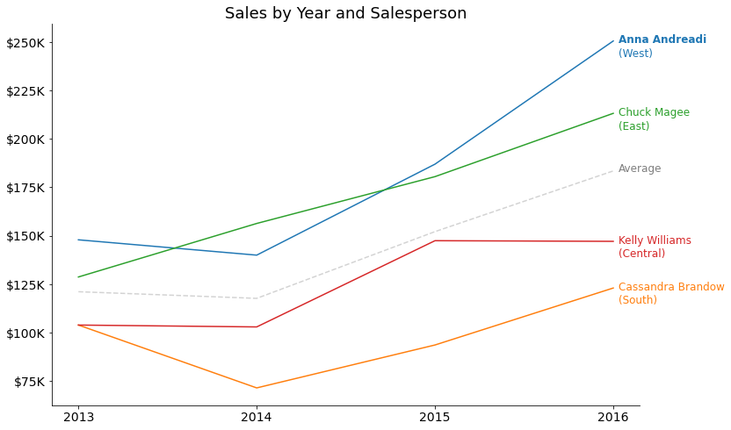
Anna Andreadi was the top salesperson in 2016
Anna Andreani hit record high sales in 2016 coming in at over $250K and performed 37% above average
Chuck and Cassandra also hit record high sales for their regions in 2016 at $213K for the West and $123K for the South
Overall sales have been on an upward trend over the last two years, increasing by +29% in 2015 and +21% in 2016

Slide 4
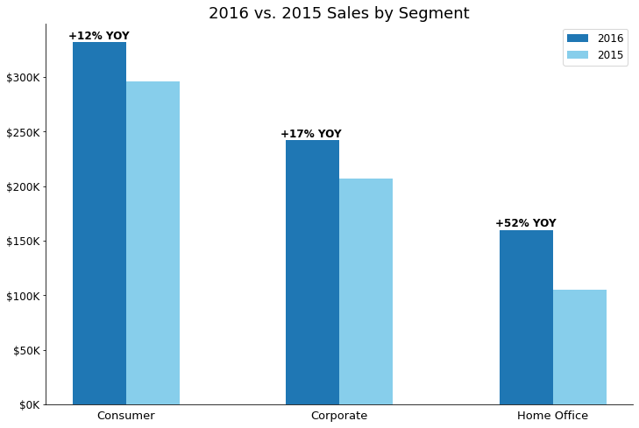
Sales increased YOY across all segments
Overall segment sales increased +$125K in 2016 from the year prior, totaling $734K for the year
The Consumer segment drove the strongest sales in 2016 at $332K, driving 45% of overall segment sales for the year
While Home Office drove the lowest sales at $183K, this segment drove the strongest improvement YOY increasing sales by +52% since 2015

Slide 5
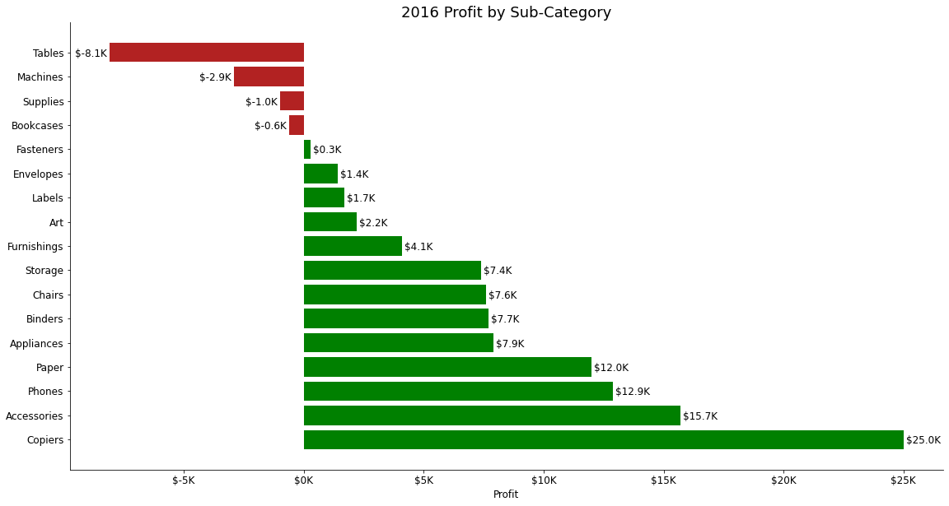
Four sub-categories had negative profit margins in 2016
Tables had the lowest performing margin in 2016 at -$8.1K, followed by machines at -$2.9K, supplies at -$1K, and bookcases at -$0.6K
Copiers performed significantly stronger than other sub-categories in 2016 at a +$25K profit margin
Net profit is positive at $94K across all sub-categories
Recommendation: Review pricing for negative profit items and discuss options

Slide 6
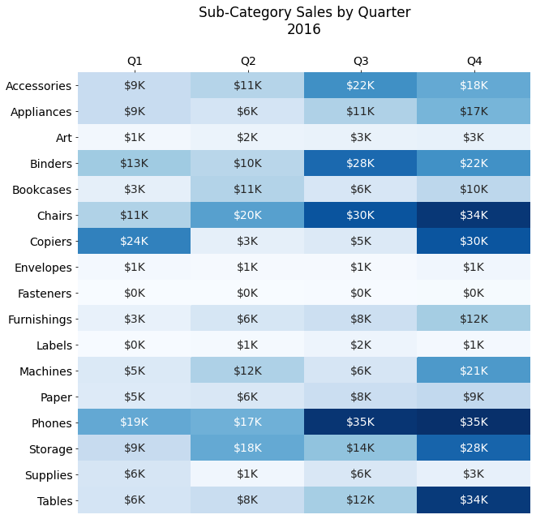
Q4 is the strongest quarter, however seasonality varies by sub-category
Tables have the most extreme seasonality, with 57% of sales in 2016 coming from Q4
Phones also have high seasonality in 2H, posting double the sales compared to the first half of 2016
Back-to-school items like binders, art, supplies, and accessories have highest seasonality in Q3
Recommendation: Use seasonality windows to focus marketing efforts and drive inventory needs

Slide 7
Conclusion
Overall sales have been on an upward trend over the last two years, increasing by +29% in 2015 and +21% in 2016
Sales increased across all segments – Consumer, Corporate, and Home Office – by +$125K YOY to a total of $734K in 2016
Four sub-categories showed negative profit in 2016: Tables, Machines, Supplies, and Bookcases
Seasonality varies by sub-category, however Q4 is the strongest overall
Recommendations:
Review pricing on low profit items and discuss options with wholesalers
Use product seasonality windows as guidance for marketing and promotional efforts and inventory needs

